Slide 1
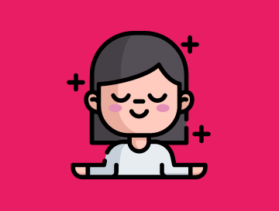
Psynode
Your Mental Health Assistant
-Team Firebolt

Slide 2
Mental Health- A brief outlook of present situation
As per WHO, India has 0.3 Psychiatrists, 0.07 Psychologist per lakh of its population, as opposed to the desirable no 3. 7.5 % of population suffer from Mental disorders, 56 million in depression and 38 million -anxiety 36% of suicides globally only in India Stigma related to Mental health is widespread. Estimated 1 trillion dollar economic loss due to bad mental health!

Slide 3

CoronaVirus
It has proved to accelerate mental issues globally.
Unexpected Loneliness Lockdown and social distancing
Emotional Stress Fear of loss of loved ones, bereavements and job loss
Exposure to Internet Main cause for panic and health anxiety

Slide 4
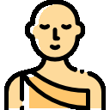
Problem Statement:
Creating a tool that can provide long term/permanent relief from stress related mental health issues using technology enabled accessibility and digital devices.

Slide 5
The Solution: Breathing
1. You can remain 3 weeks without food, 3 days without water, but only
3 minutes without air!
2. What do you do to improve health? We focus on things that we can survive without the longest- food/ drink more water? But what about something that we do 23000 times a day?
3. Breathing! - And if you are doing it wrong, you are doing it wrong, 23000 times a day!

Slide 6

The fight or flight response
Normal mode: Relax Mode(natural)- body repair, digestion, immune system activated. MAXIMUM optimisation of energy Panic mode: Activates under emergency situation. (Short term)- burst of energy, increased blood supply, all normal system brought to halt to utilise MAXIMUM energy

Slide 7
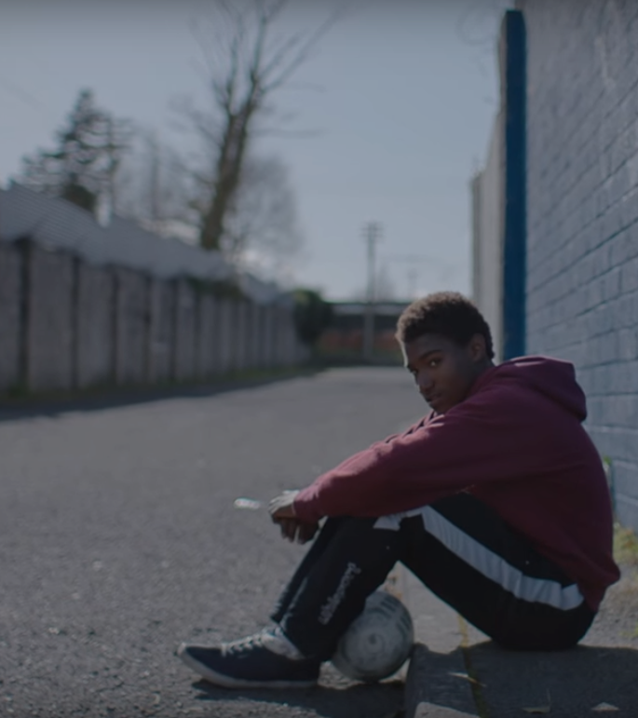
What if body fails to switch back to normal mode?
Anxiety, Depression, OCD, Stress, worrying, loss of focus and ability to enjoy life!

Slide 8
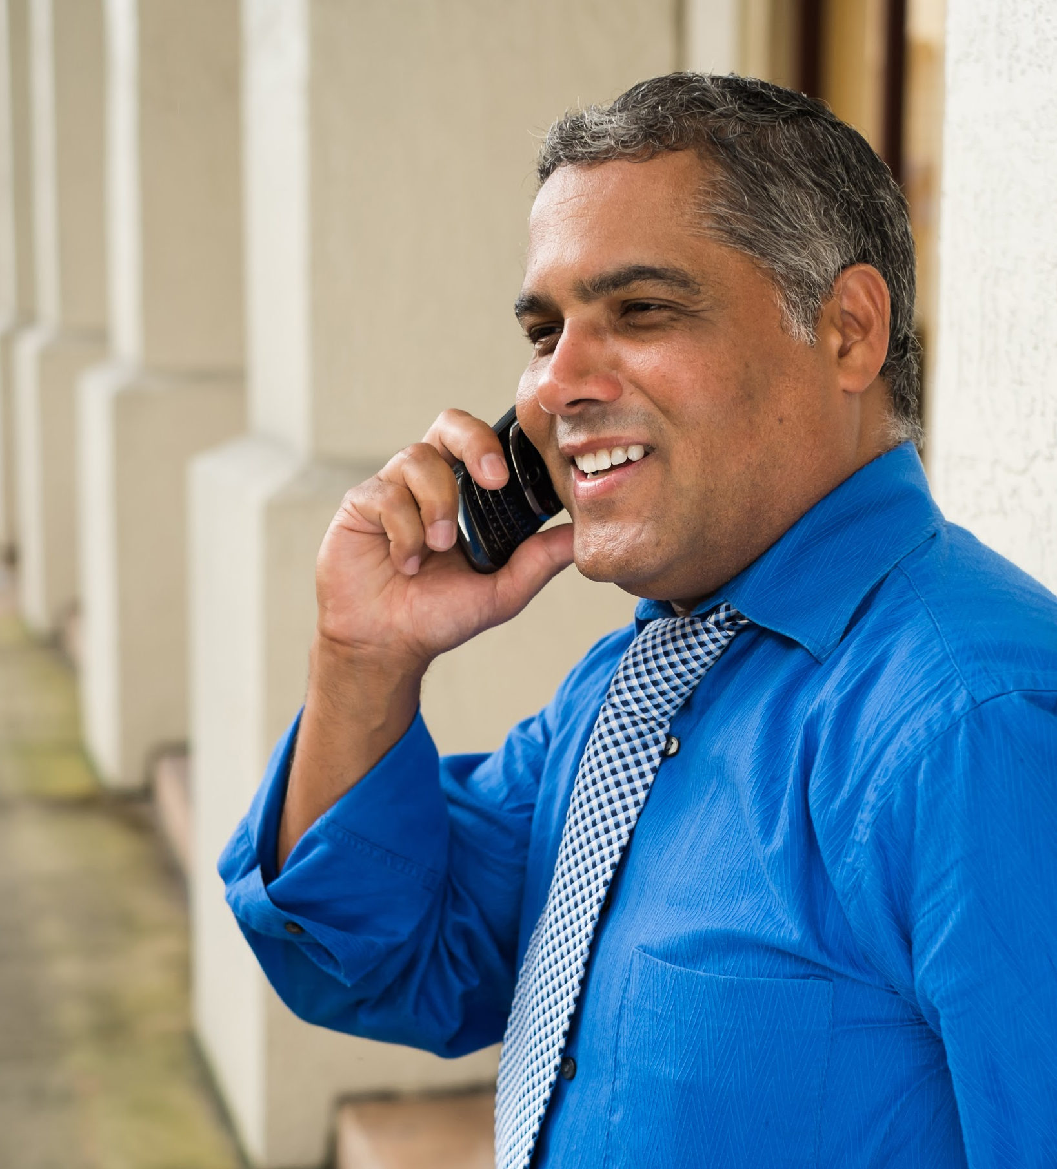
Our solution: Using breathing patterns to bring back body into Normal mode. How? In normal mode: Breathe in less, Breathe out more In panic mode: Breathe in More , Breathe out less
He recently opened a camera shop near the Louvre in Paris.
Visitors to his store, mostly tourists, speak many different languages making anything beyond a simple transaction a challenge.

Slide 9
Our Tech Stack
HTML, CSS (SASS) JavaScript-->(Framework) Local Storage-->(MongoDb)
Output: Chrome Extension

Slide 10
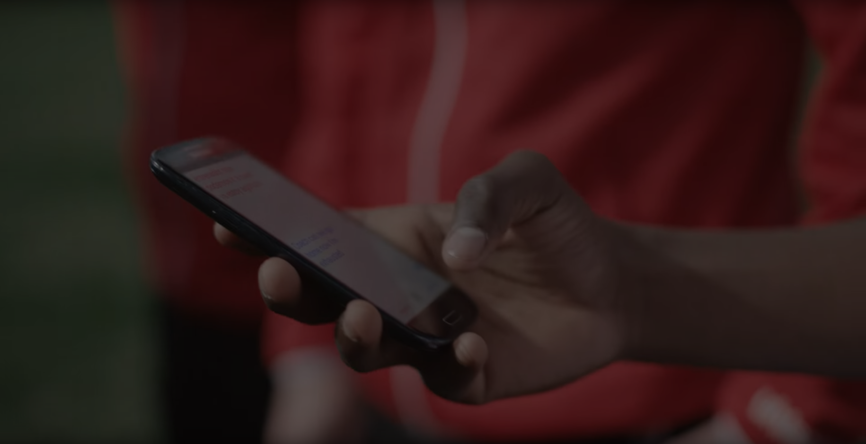
Our app will train the user to breathe correctly and maintain a record to provide timely progress reports

Slide 11
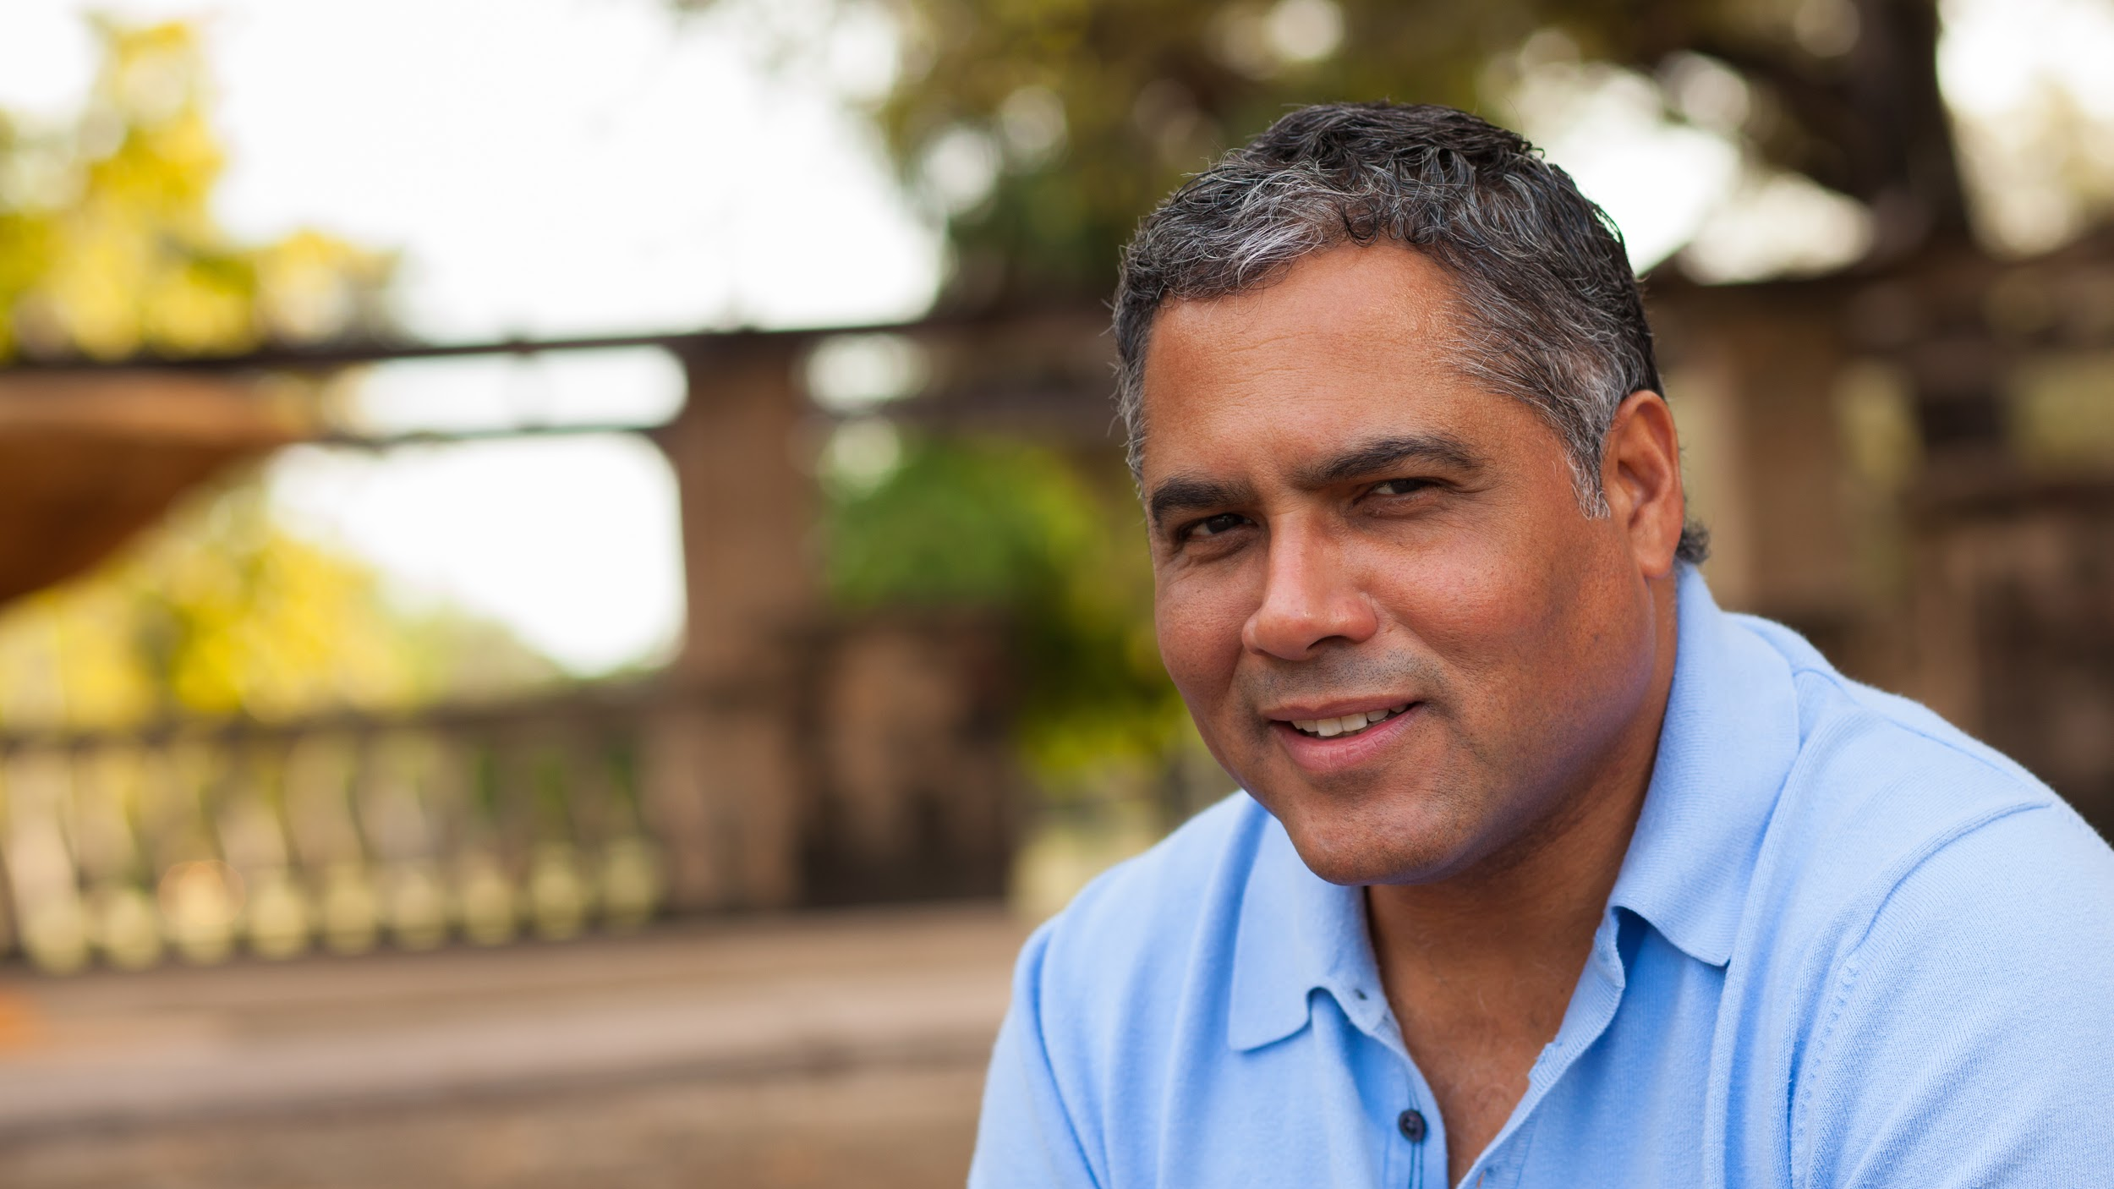
Once breathing pattern is restored, next stage is unlocked.

Slide 12
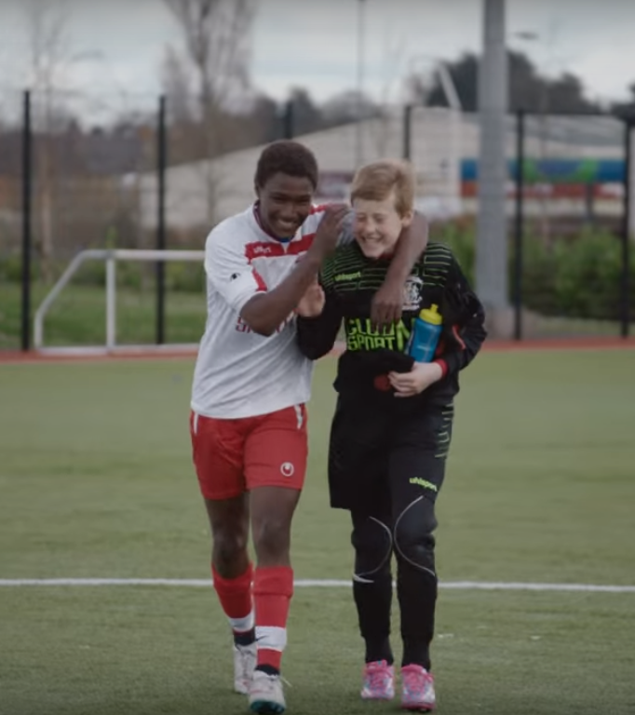
Our target users?
People who spend most time on Devices- The IT + ITes professionals and students
A simple chrome extension that converts their 5 min into health restoration.

Slide 13
Way forward...
Include a information exchange system that will include other parameters like sleep cycle and physical fitness data from trackers.
Eye care and Meditation
Eating the right way

Slide 14
Team Members:
Aditya Narayan Singh
Devanshu Tiwari Suraj Mane Vinoo Prakash

